Slide 1
Origin Placement

Slide 2
Contents
The Organisation
Individual Role
Legacy Project
Key Experiences
Final Word

Slide 3
Origin – The Organisation
General Background:
Energy retailer and producer.
Building a sustainable energy future.
Data and Origin:
Jindabyne – Origin’s data lake.
Tableau - Origin’s data visualization tool.

Slide 4
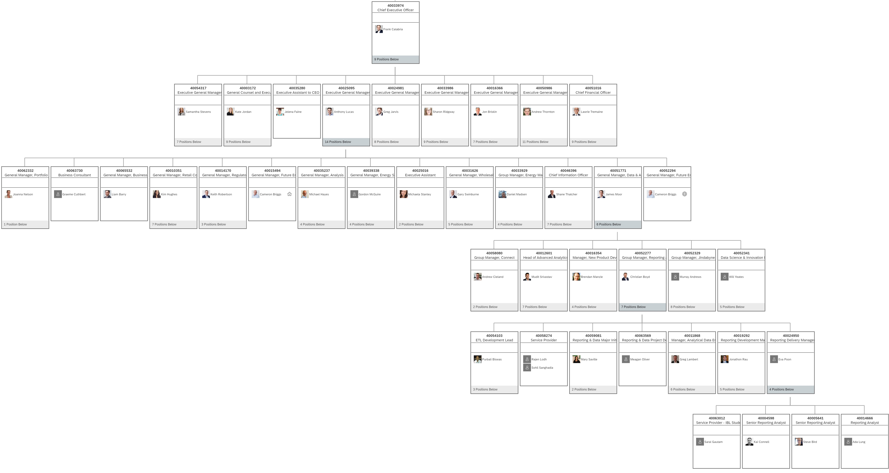

Slide 5
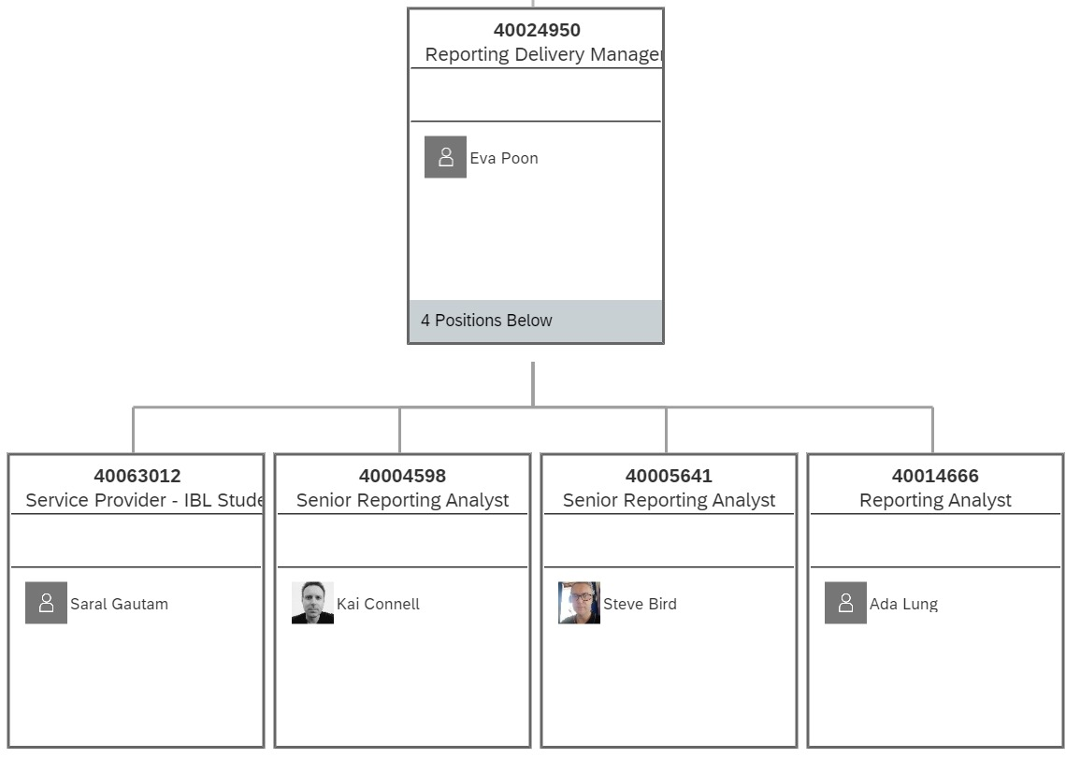
Reporting and Data Operations

Slide 6
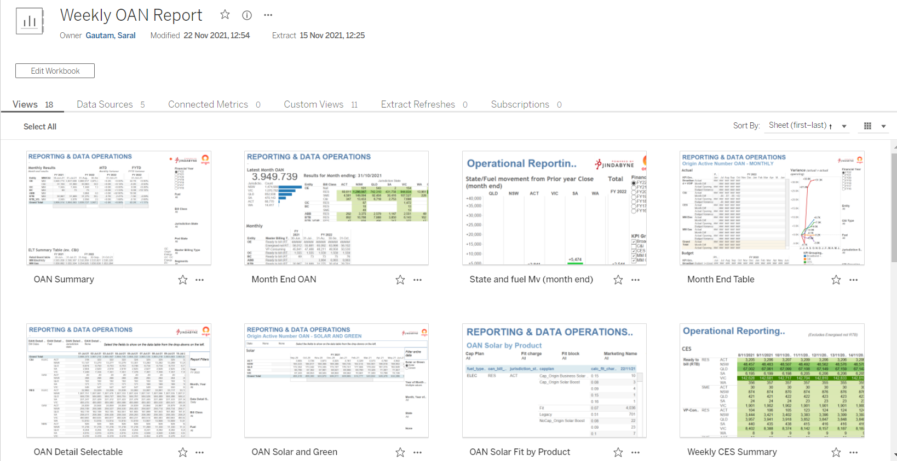
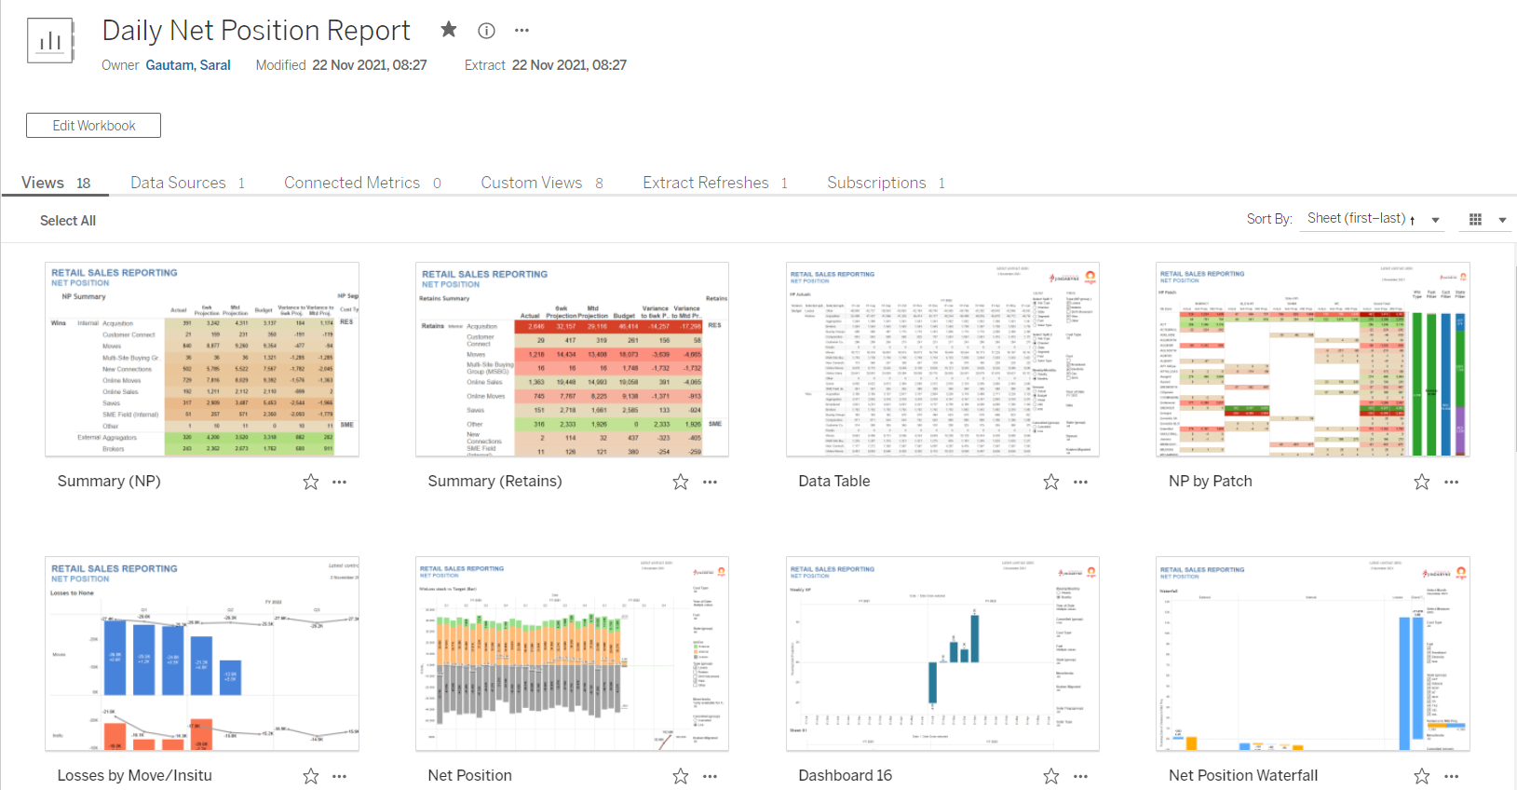
The Individual Role
OAN (Origin Active Number)
Total number of accounts
Net Position: Wins - Losses

Slide 7
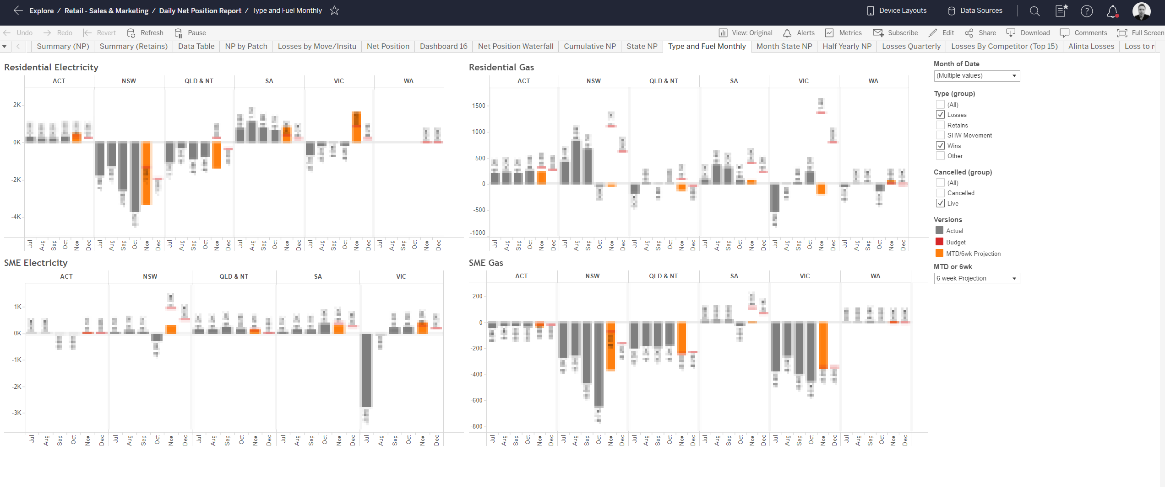
Views

Slide 8
Teams
Data Analytics
Sustainability
Finance, Retail Commercial
Sales and Marketing
Origin Retail

Slide 9
Legacy Project
Sustainability Data Capture (SDC)

Slide 10
Sustainability Data Capture (SDC)
General Background:
Flask web application.
Input and review results.
Origin Sustainability Report.

Slide 11
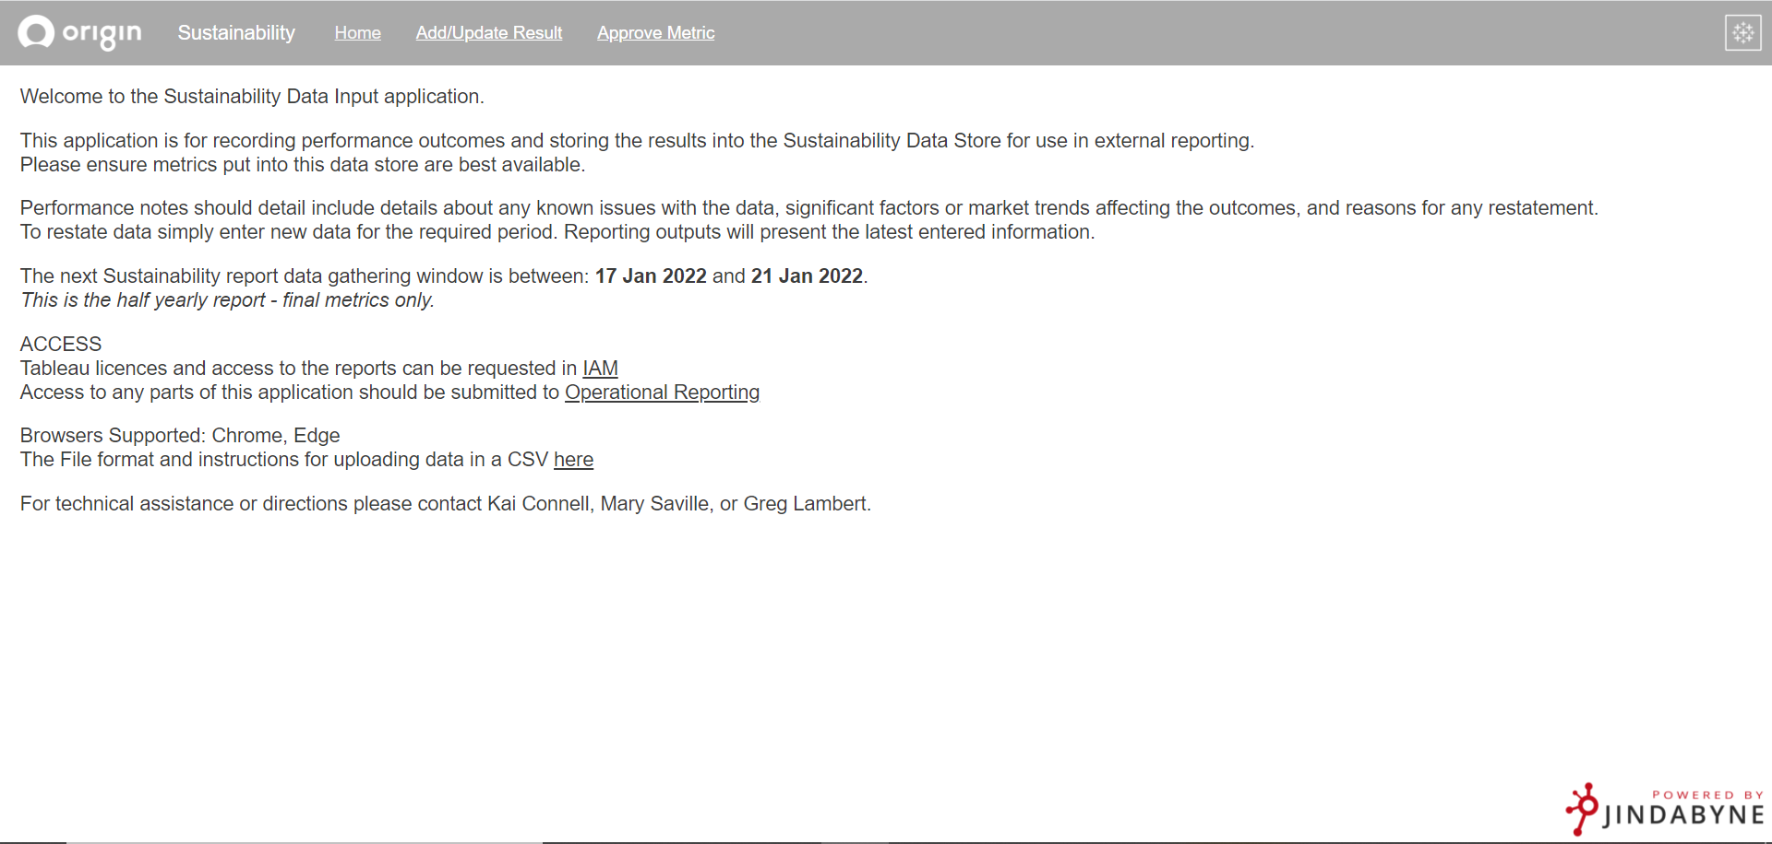
Home Page

Slide 12
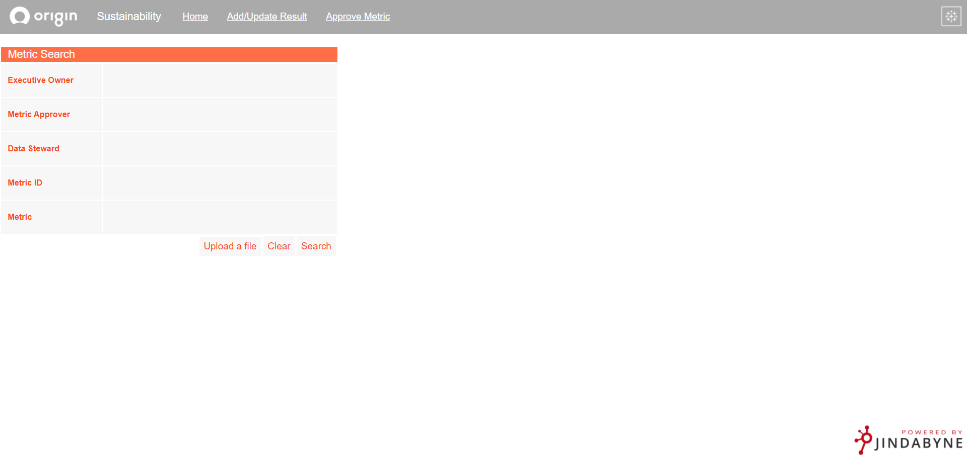
Search

Slide 13
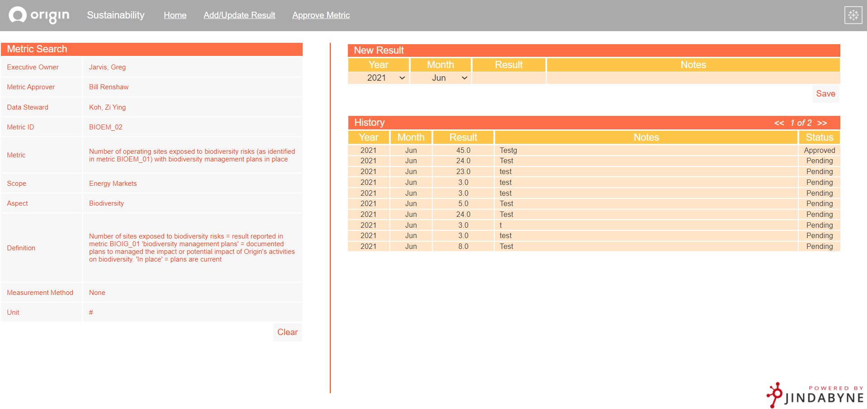
Searched Metric

Slide 14
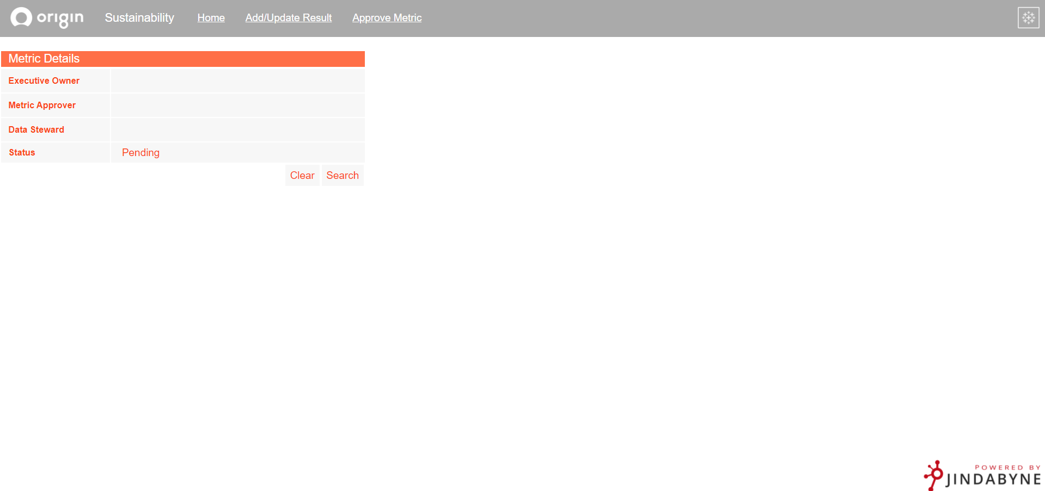
Approval Page

Slide 15
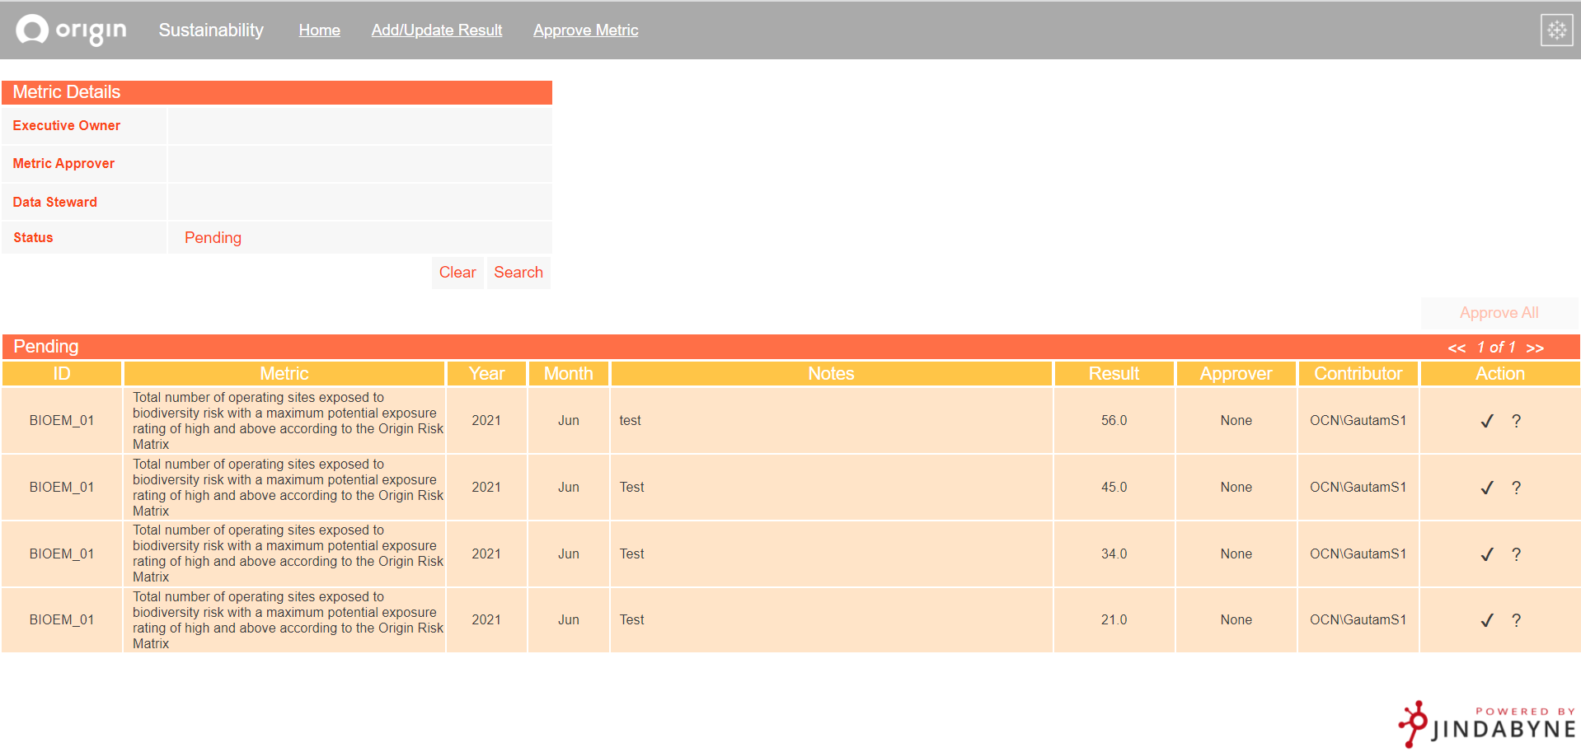
Approval Page

Slide 16
Key Experiences

Slide 17
Backstory
Retrieve username without login prompt.
Make application more user friendly.
Very specific coding problem.

Slide 18
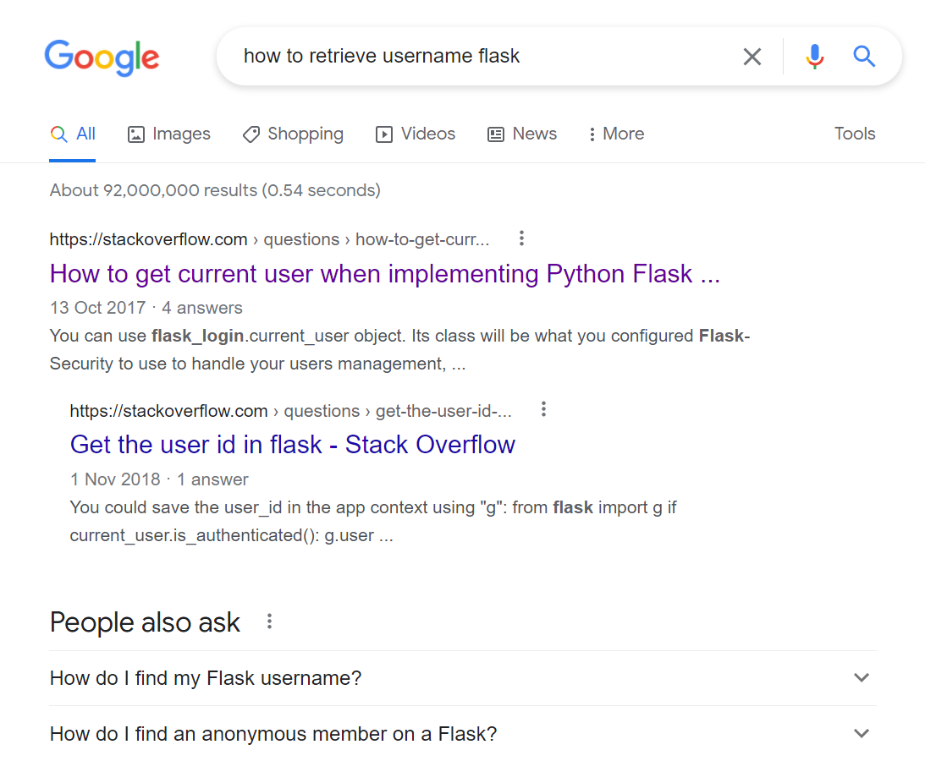
Workflow: Search, try and fail.
Problems?
Time-consuming
No progression to solution

Slide 19
“It is already there”
“Where?”
“The documentation”

Slide 20
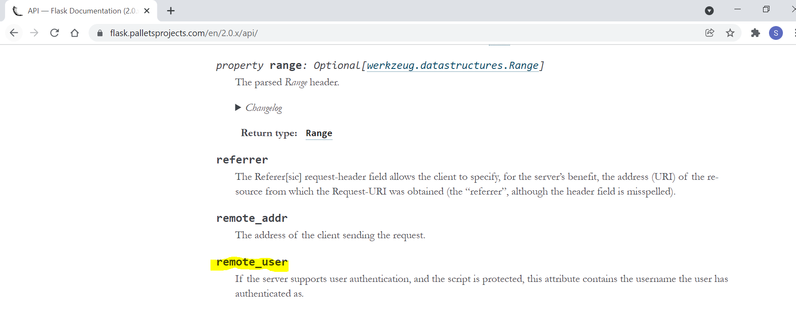

Slide 21
Search

Slide 22
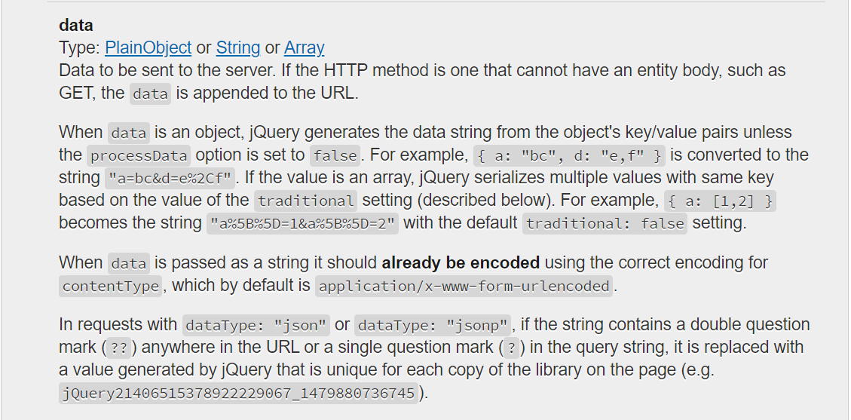

Slide 23
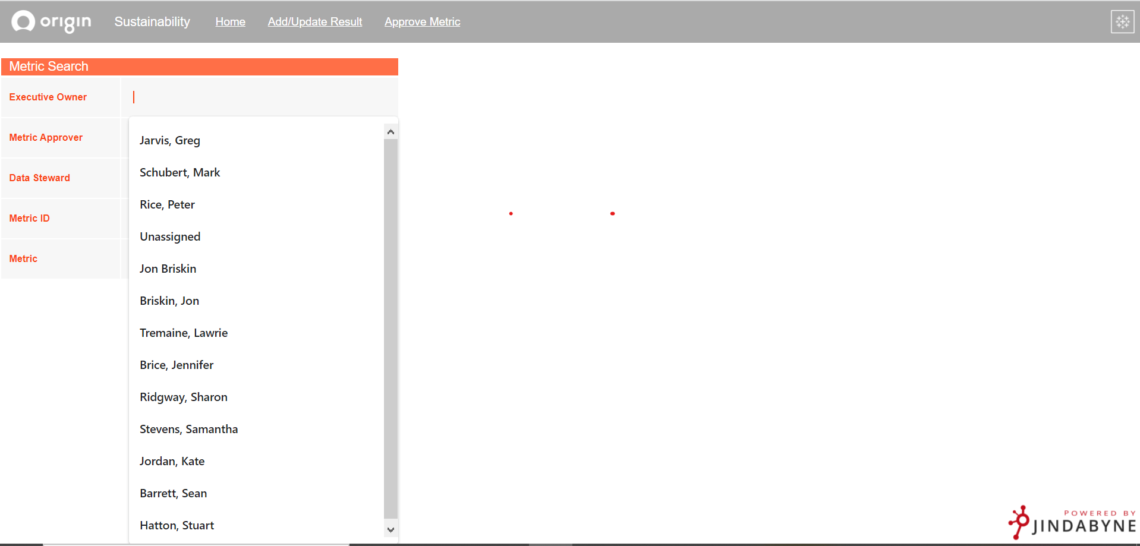

Slide 24
Read the documentation
Saves time and progressively approach a solution.

Slide 25
Origin and Users
Common phrases for the reporting team:
“Can you make a view that can show me…?”
“Can this data source be filtered by ...?”
“Is it possible to …?”
“Can we add…?”

Slide 26
Point A: The Starting Position
Point B: User Expectation

Slide 27
Approach?
Point A: The Starting Position
Point B: User Expectation

Slide 28
feature
Start
Teams Message Meeting

Slide 29
Feature
More Feedback
Start
Next Feature
Teams Message Meeting

Slide 30
Feature
Question
More Feedback
Start
Next Feature
Teams Message Meeting
Adjustments

Slide 31
Feature
Question
More Feedback
Start
Next Feature
Stakeholder
Teams Message Meeting
Adjustments

Slide 32
Feature
Question
Deploy
More Feedback
Start
Stakeholder
Finish
Next Feature
Teams Message Meeting
Adjustments
User expectation met

Slide 33
Sustainability Workflow
Start
Finish

Slide 34
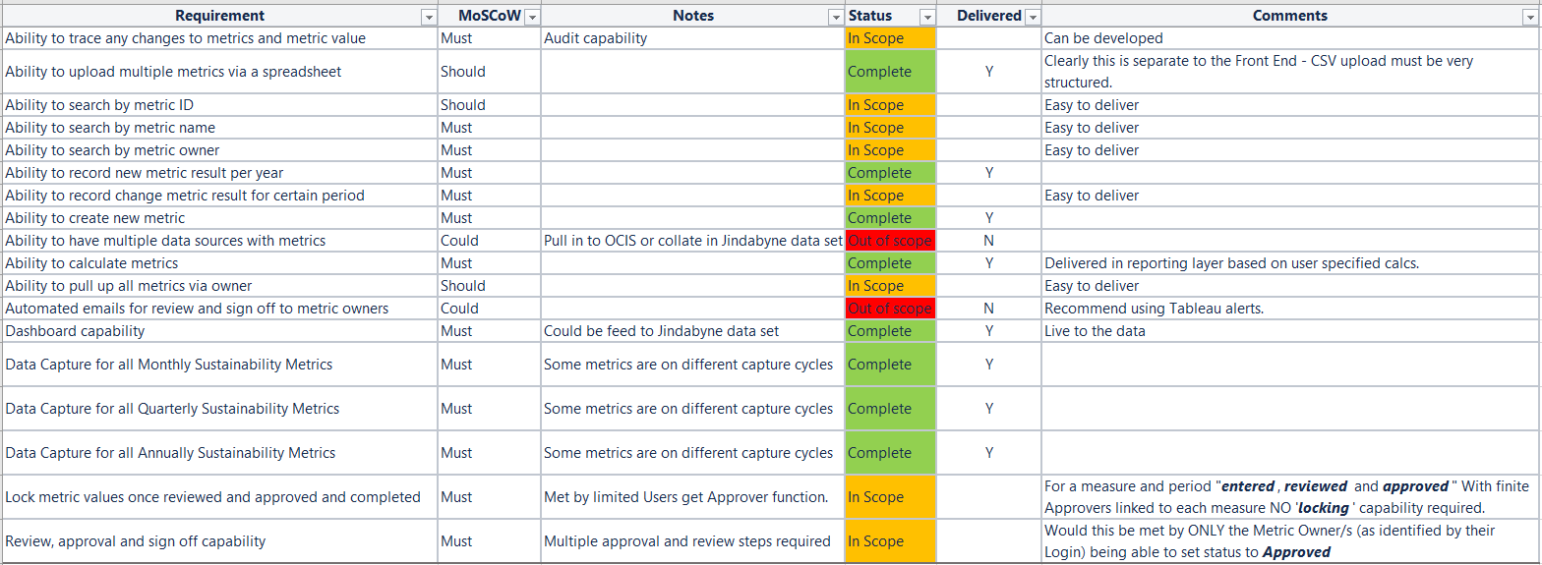
Point B

Slide 35
Sustainability Workflow
Front end
Start
Finish
Teams Message Meeting

Slide 36
Sustainability Workflow
Front End
More Feedback
Start
Finish
Search
Teams Message Meeting

Slide 37
Sustainability Workflow
Front end
Approval
More Feedback
Start
Finish
Search
Teams Message Meeting
Adjustments

Slide 38
Sustainability Workflow
Front end
approval
More Feedback
Start
spreadsheet
Finish
search
Teams Message Meeting
Adjustments

Slide 39
Sustainability Workflow
Front end
approval
Deploy
More Feedback
Start
spreadsheet
Finish
search
Teams Message Meeting
Adjustments
User expectation met

Slide 40
Targeted Questions
Reach Point B without a path from Point A.

Slide 41
Start
Finish

Slide 42
Structure your code
What is it?

Slide 43
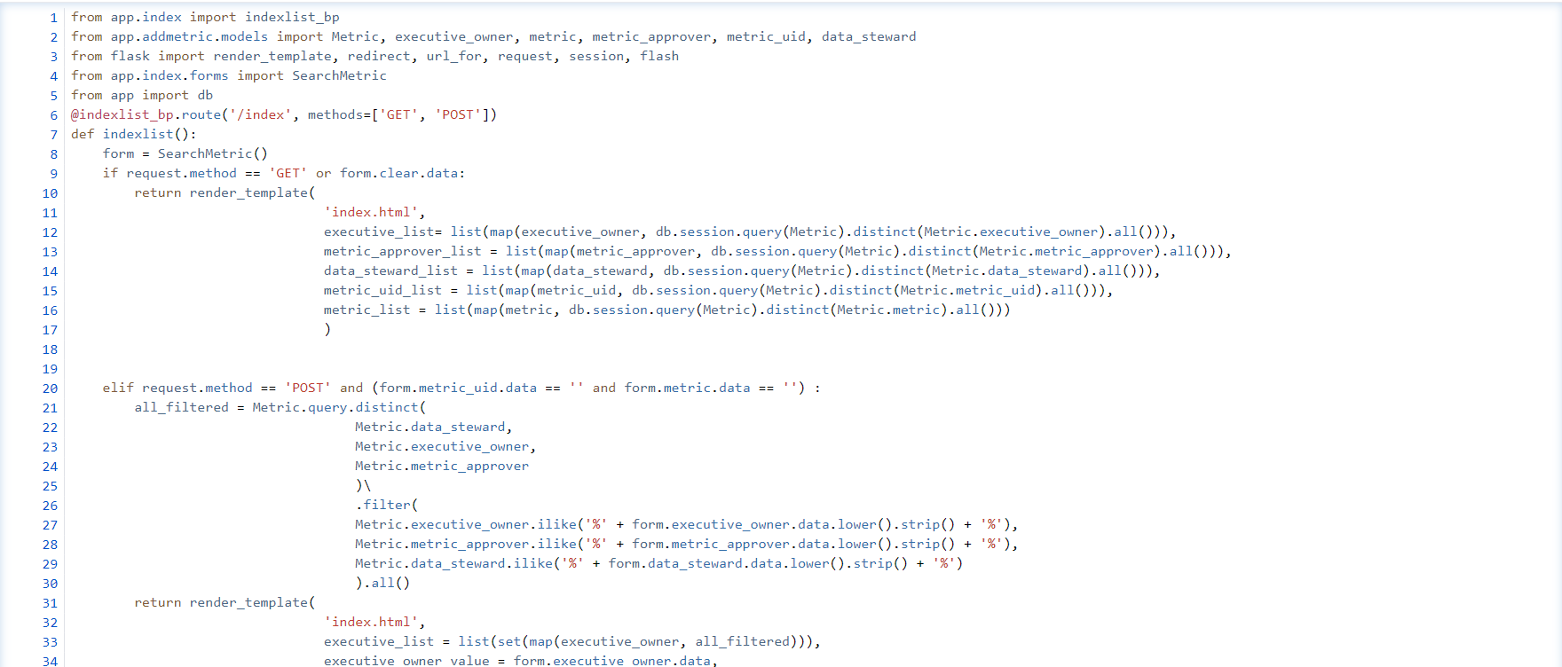

Slide 44
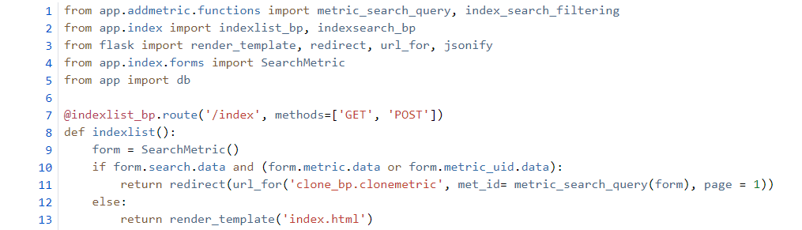


Slide 45
Code Structuring
Easier debugging
Easier to read
Removes need for commenting

Slide 46
Structure your code
Make changes faster.

Slide 47
Reverse Side
Technical | Soft
Read the documentation | Asking for help when needed
Targeted Questions | Involve the user
Structuring code | Receiving and acting upon feedback

Slide 48
Soft Skills
Direct your technical focus.

Slide 49
Final Say
More knowledgeable.
Aware of career opportunities.
Learnt industry standard.
Had a great time working.

Slide 50
Thanks for listening

